Slide 1



Machine learning as an auxiliary tool for computational chemistry
XXII Brazilian Symposium on Theoretical Chemistry
Dr. Henrique de Castro Silva Junior

Slide 2
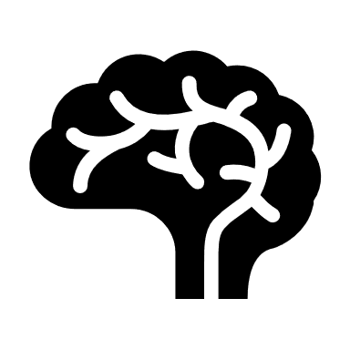
Day 4 Deep Neural Networks

Slide 3

The Universal Function Approximator

Slide 4
The Universal Function Approximator
Any continuous function can be accurately approximated by a Feed Forward Deep Neural Network given the necessary amount of data with a finite number of neurons and hidden layers.
Cybenko, G. Approximation by superpositions of a sigmoidal function. Math. Control, Signals Syst. 2, 303–314 (1989).
Haussler, D., Siegelmann, H. T. & Sontag, E. D. On the computational power of neural nets. Proc. fifth Annu. Work. Comput. Learn. theory 440–449 (1992)
Brüel-Gabrielsson, R. Universal Function Approximation on Graphs. arXiv (2020) doi:10.48550/arxiv.2003.06706.
Choi, Y., El-Khamy, M. & Lee, J. Universal Deep Neural Network Compression. arXiv (2018)
Lu, Y. & Lu, J. A Universal Approximation Theorem of Deep Neural Networks for Expressing Probability Distributions. arXiv (2020) doi:10.48550/arxiv.2004.08867.
Heinecke, A., Ho, J. & Hwang, W.-L. Refinement and Universal Approximation via Sparsely Connected ReLU Convolution Nets. IEEE Signal Process. Lett. 27, 1175–1179 (2020).

Slide 5
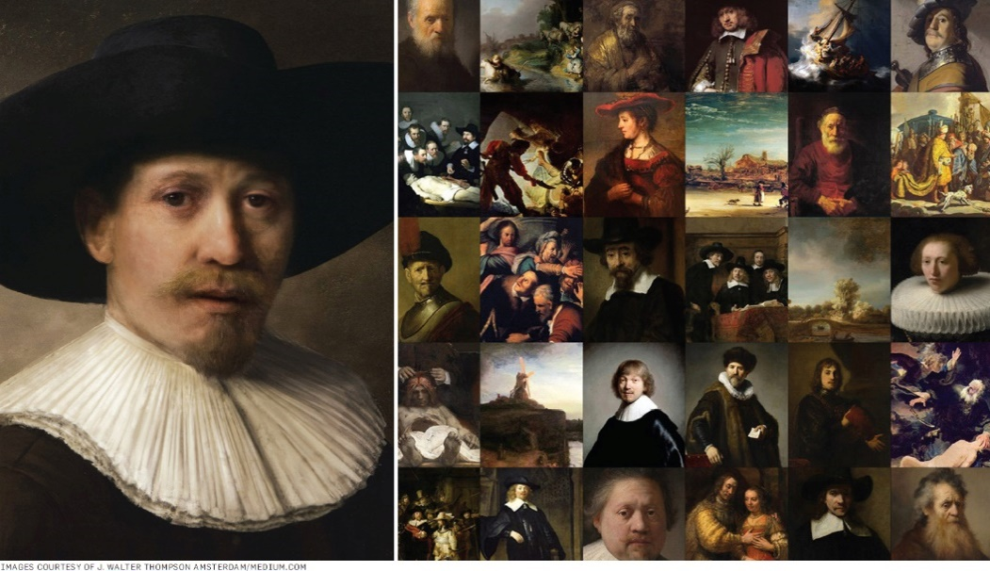
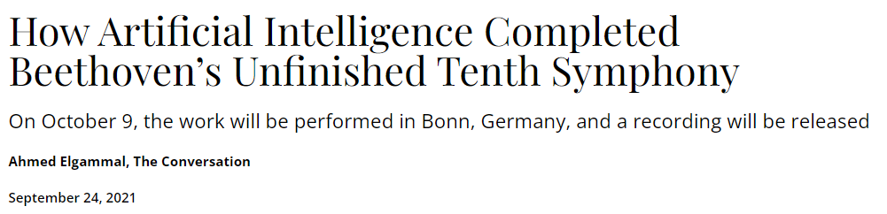
The Universal Function Approximator
(A) Data in the Life: Authorship Attribution in Lennon-McCartney Songs
Harvard Data Science Review, 1(1)

Slide 6


Slide 7
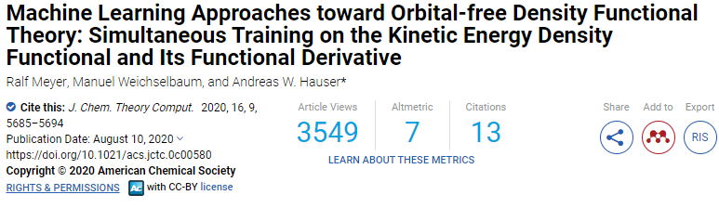
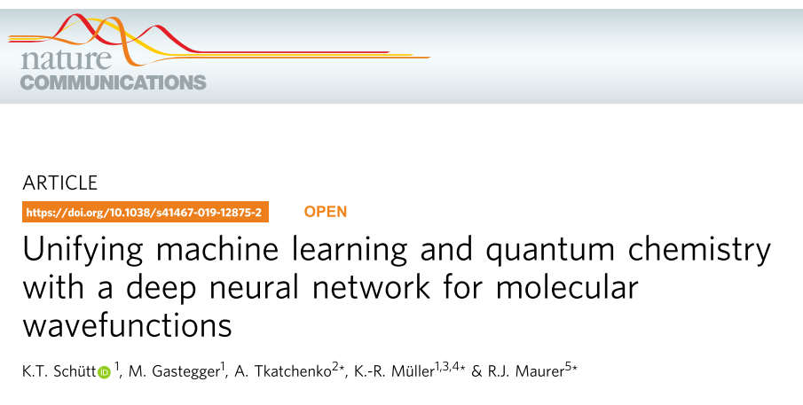
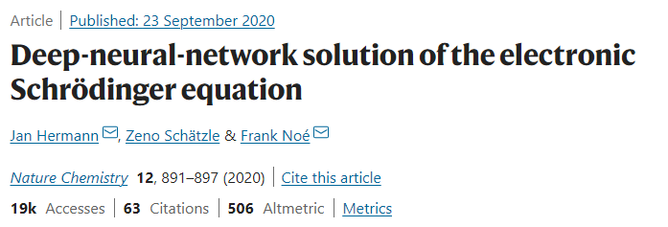
The Universal Function Approximator

Slide 8
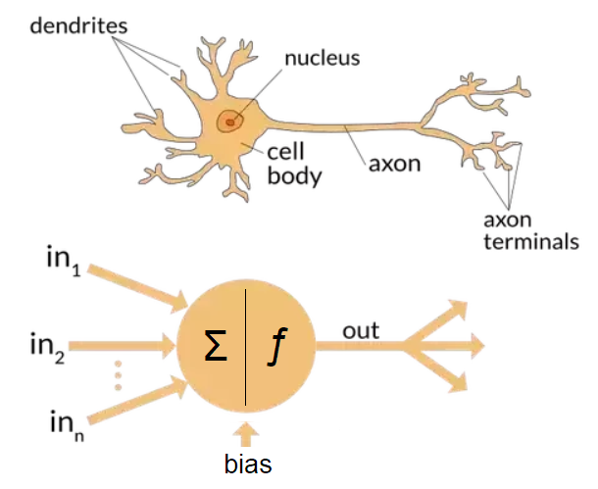
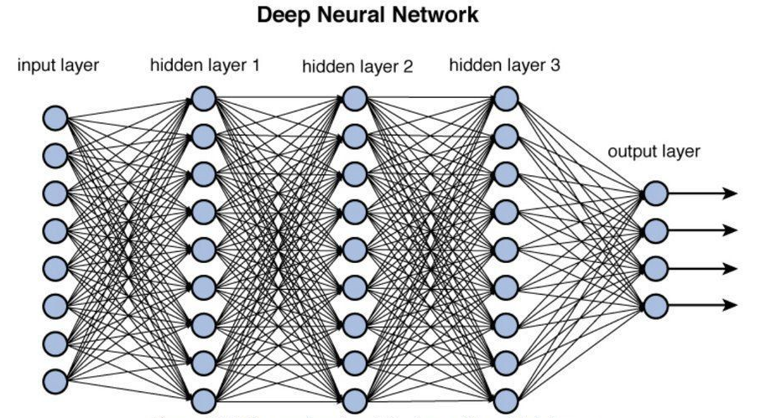
The Universal Function Approximator

Slide 9
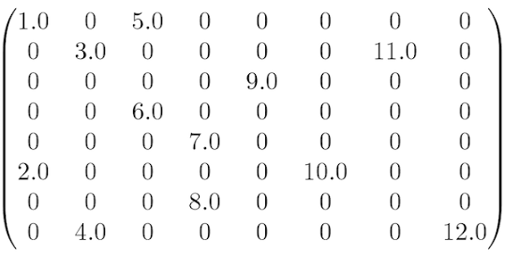
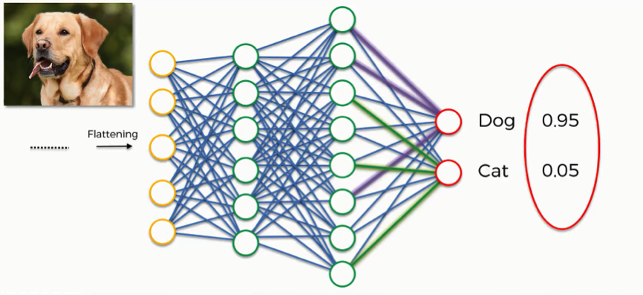

Slide 10
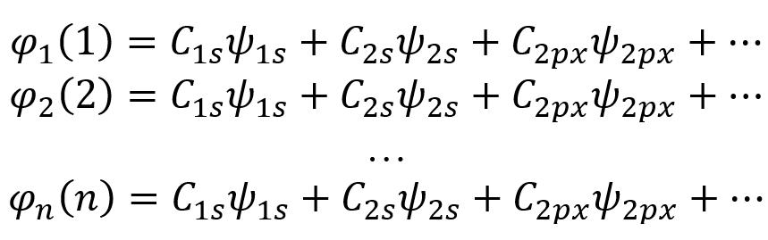
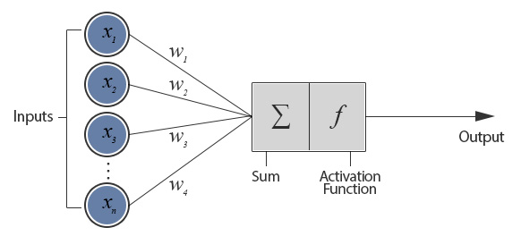

Slide 11
Activation function - Wikipedia

Slide 12
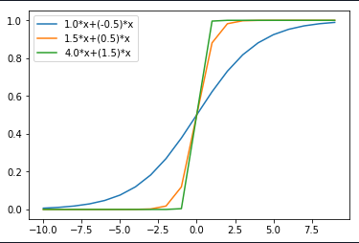
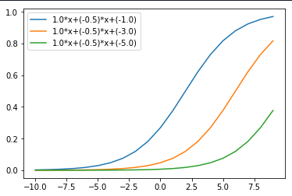
Activation function - Wikipedia
Bias

Slide 13
y
Bias

Slide 14

Learning rate: how fast the weights change
Batch size: How many examples to use at each step
y
Bias
Imagine adjusting for dozens, hundreds, thousands of neurons…

Slide 15
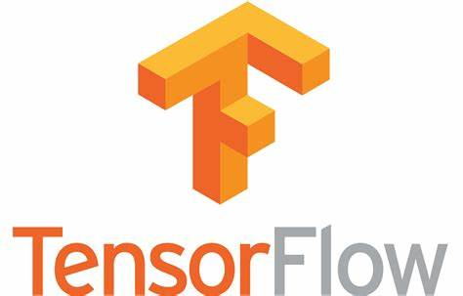
Exemplo online
https://playground.tensorflow.org/

Slide 16
Learning rate: how fast the weights change
Batch size: How many examples to use at each step
y
Bias
Imagine adjusting for dozens, hundreds, thousands of neurons…

Slide 17

Optimizers!

Slide 18
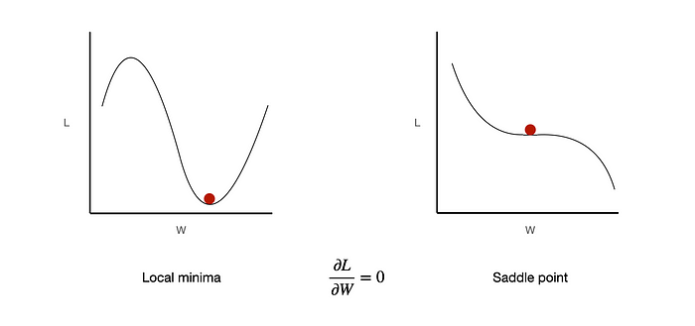
Optmizers
Optimizers are algorithms that are used to minimize the loss function when training a machine learning model. The loss function measures how well the current model parameters (weights and biases) are able to fit the training data.
Algorithms to update model parameters
Minimize the loss function
Improve model performance

Slide 19
Optmizers
Optimizers are algorithms that are used to minimize the loss function when training a machine learning model. The loss function measures how well the current model parameters (weights and biases) are able to fit the training data.
Optimizer | Batch Size | Speed | Memory Usage | Adaptive Learning Rate | Key Features
Gradient Descent | Full dataset | Slow | High | No | Simple, may be slow for large datasets
SGD | 1 | Fast | Low | No | High variance, noisy updates
Mini-batch GD | 1 < x < Full | Med | Med | No | Trade-off between GD and SGD
Momentum | Varies | Fast | Med | No | Adds momentum to accelerate convergence
Adagrad | Varies | Med | Med-High | Yes | Good for sparse data, may have diminishing learning rates
RMSprop | Varies | Fast | Med | Yes | Adapts learning rates, solves Adagrad's limitations
Adam | Varies | Fast | Med | Yes | Combines Momentum and RMSprop

Slide 20


Optmizers
Optimizers are algorithms that are used to minimize the loss function when training a machine learning model. The loss function measures how well the current model parameters (weights and biases) are able to fit the training data.

Slide 21

The capricious bad side

Slide 22
The bad side
High computational cost
Training deep neural networks requires large amounts of data, computing power, and time. They are computationally expensive to train compared to other machine learning techniques.
Overfitting
Deep neural networks with a large number of parameters can easily overfit training data, reducing their ability to generalize to new data. Regularization techniques are required to avoid overfitting.
Lack of interpretability
The internal representations and decision-making processes of deep neural networks are generally difficult for humans to interpret. This "black box" nature makes debugging and improving deep learning models challenging.
Dependence on data quality
Deep learning models are highly dependent on large amounts of high-quality training data that accurately represents the problem domain. Insufficient or poor-quality data can significantly degrade model performance.

Slide 23
The bad side
Vulnerability to adversarial examples
Deep neural networks can be fooled by adversarial examples - inputs that are intentionally designed to cause the model to make mistakes. This raises security concerns.
Difficulty in evaluating performance
It can be hard to diagnose issues and compare performance between different deep learning architectures. The complex and non-linear nature of deep neural nets makes evaluation difficult.
Requires expertise in tuning and optimization
Getting deep neural networks to train properly involves substantial expertise in hyperparameter tuning, network architecture design, feature engineering, and optimization techniques. Lack of expertise can result in poor model performance.

Slide 24
Hyperparameter optimization:
Architecture-related
Number of Hidden Layers
Number of Units/Neurons in Hidden Layers
Initial Weight
Training-related
Learning Rate
Batch Size
Epochs
Optimizer
Momentum
Regularization
Dropout Rate
Learning Rate Schedule
Activation Functions
Hidden Layer Activation
Output Layer Activation
Loss Functions
Classification Loss (e.g., Cross-Entropy)
Regression Loss (e.g., Mean Squared Error)
Data-related
Feature Scaling
Data Augmentation

Slide 25
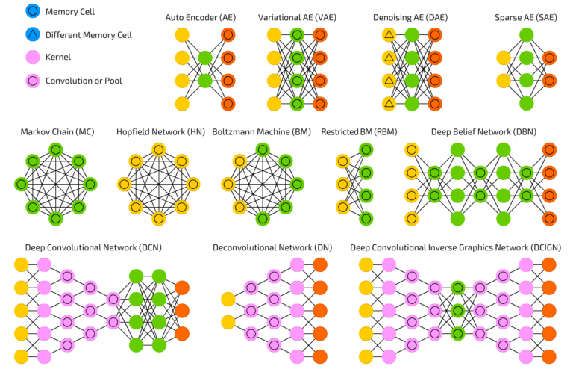
Several flavors
Feedforward Neural Networks (FNN)
Convolutional Neural Networks (CNN)
Recurrent Neural Networks (RNN)
Graph Neural Networks (GNN)
Autoencoders
Variational Autoencoders (VAE)
Generative Adversarial Networks (GANs)
...

Slide 26

In Python…

Slide 27
Tomorrow: From Start to Finish: DNN in Practice
SBQT Day 5

